Slide 1


Introduction To Machine Learning

Slide 2

Takeaways from today’s session
Introduction to Data Science
Step into the world of DS
Introduction to ML
Linear and Logistic Regression
Decision Tree and Random Forest
Boosting
SVM
Stacking
Unsupervised Learning
AutoML and Research Methodology

Slide 3
Takeaways from today’s session
Introduction to Machine Learning
Types of Machine Learning
Model evaluation metrics
How to explain Machine Learning models?

Slide 4
Emergence of Machine Learning
What is Machine Learning
Emergence of Machine Learning
Types of Machine Learning
Model Evaluation
Model Explainability

Slide 5

Machine learning in everyday life!

Slide 6
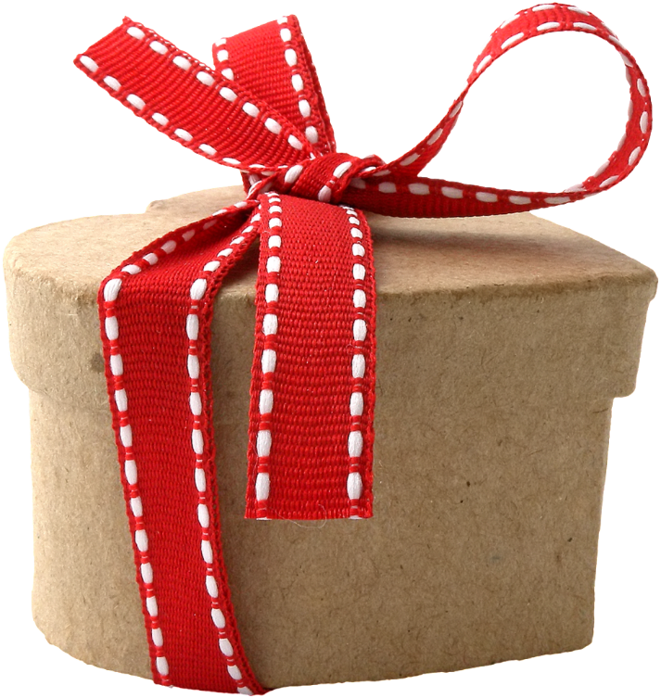
Let’s make a friend happy!
John suddenly remembers it is Joe’s birthday and decides to buy a birthday gift

Slide 7



Purchase and choose a birthday gift
John decides he would buy a mystery novel as a gift.
Joe is fond of mystery novels

Slide 8



Google search to the rescue
John starts searching internet for good mystery novels
Google produces relevant search results within a matter of seconds!

Slide 9


Making an online purchase through Amazon
John navigates to amazon from the search results
John chooses Joe’s favorite author Jeffery Archer

Slide 10

Alternative book recommendations are presented
John also gets other book recommendations written by Jeffery Archer from Amazon which widens his options.

Slide 11

Check email to track delivery
John purchases the book and wants to now track delivery.
Gmail detects Amazon is a trusted source and filters email into inbox (does not categorize it as spam)

Slide 12
John wonders how seamlessly he could buy this gift and how Amazon makes this possible?
The answer is Machine Learning!
Let’s hear it from the technology giants themselves..

Slide 13




Machine learning reshaping technological giants
“Machine learning and AI is a horizontal enabling layer. It will empower and improve every business, every government organization, every philanthropy. Basically, there’s no institution in the world that cannot be improved with machine learning”
-Jeff Bezos
A breakthrough in machine learning would be worth ten Microsofts.
--Bill Gates
Notes:
Eg: quotes from The economist and so on .

Slide 14
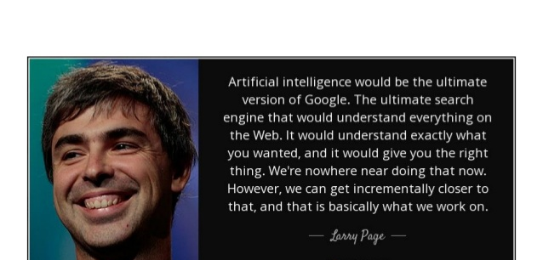
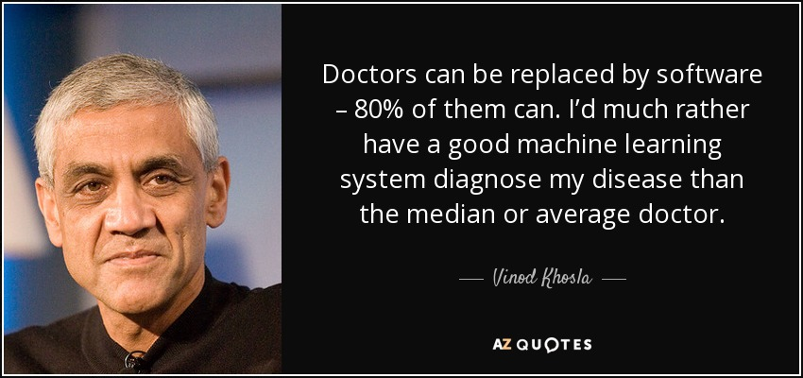
Machine learning reshaping technological giants

Slide 15
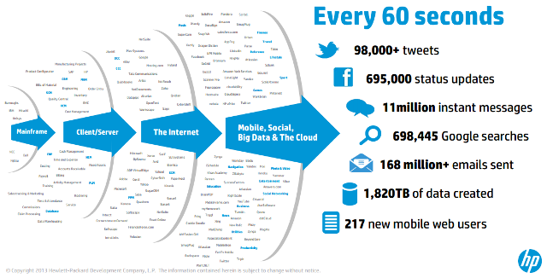
Why the need for machine learning!
Data is everywhere!
Notes:
Data is being generated in a large scale of every second, of every minute, of every hour, of every day, of every month, of every year.
We have generated more than 90% of data in the last two years itself.
And it is getting generated exponentially day by day with the increasing usage of devices and digitization across the globe.

Slide 16


Tedious task for humans made easier by Machines
All we have to do is:
Teach the machines to uncover patterns
Extraction of patterns from large amount of data can be easily accomplished by
Machines
Notes:
Data is being generated in a large scale of every second, of every minute, of every hour, of every day, of every month, of every year.
Extracting meaningful information from this huge stream of data is a difficult task for humans and to extract patterns is even more cumbersome.

Slide 17
Emergence of Machine Learning
What is Machine Learning
What is Machine Learning?
Types of Machine Learning
Model Evaluation
Model Explainability

Slide 18

What is Machine Learning?
Machine learning is the science that allows computers to learn directly from data through examples and experience.
Notes:
Machine learning is the process wherein machines learn by examples ,experience and discovery through DATA.

Slide 19
Journey of Machine learning

Slide 20

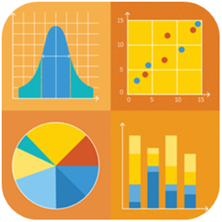
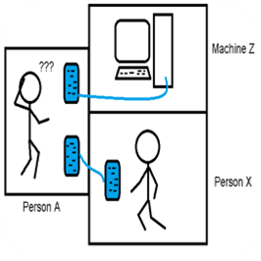
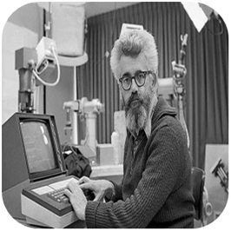
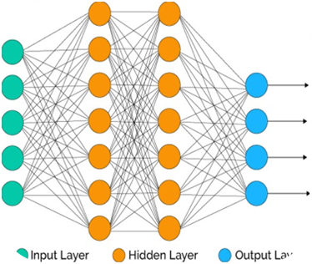
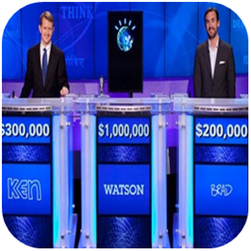
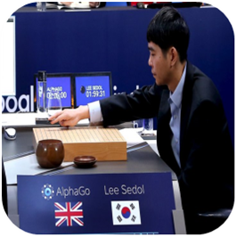
Timeline of Machine learning
David Rumelhart introduces Neural network models for machine learning
IBM’s Watson won a game of the US quiz show Jeopardy against two of its champions.
AlphaGo beats the world champion at Go
The Turing Test
The term ‘Artificial intelligence’ coined by John McCarthy
Deep Blue defeats reigning world chess champion
Development of Statistical methods
1800
18 th century
1950
1956
1986
1997
2011
2016
2018
Statistics
Computers
AI
Neural networks
IBM Watson triumphs over humans
AlphaGo beats world champion

Slide 21
If Machine learning has been there for last few decades, why is it popular now?

Slide 22
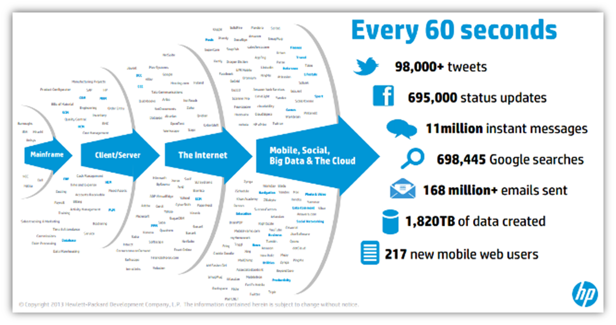
Why is Machine Learning a rage now : Data Availability
Amount of digital data being generated is huge
07

Slide 23
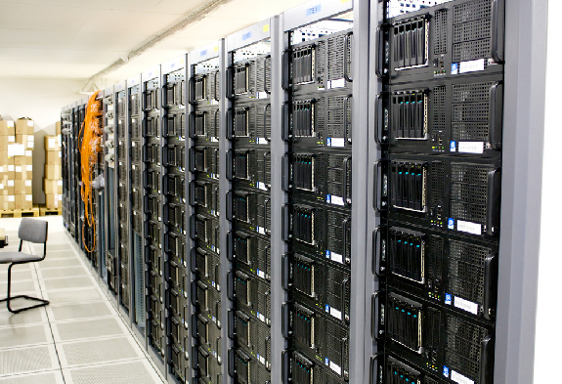
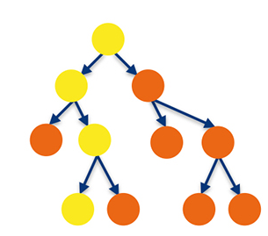
Why is Machine Learning a rage now : Computational power
Processors reliably store and analyze massive data
Building complex Machine Learning models with billions of parameters are now possible
07
Notes:
Current hardware has the capability to reliably store and analyse the massive data and perform massive amount of computations in a reasonable amount of time.

Slide 24
Let’s compare between Traditional programming and Machine Learning..

Slide 25
Pros and Cons of Traditional programming
Pros
Easier to read and understand
Error analysis is simpler
Cons
Rule based systems
Fails in many outside test scenarios
Hard coding becomes difficult for humongous data
Notes:
Machine learning is the process wherein machines learn by examples ,experience and discovery through DATA.

Slide 26
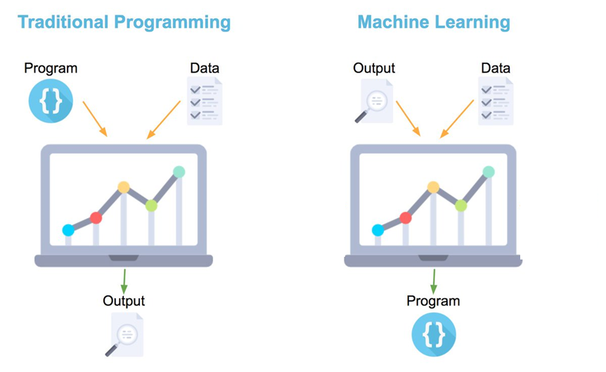
Traditional Programming vs Machine Learning
07

Slide 27

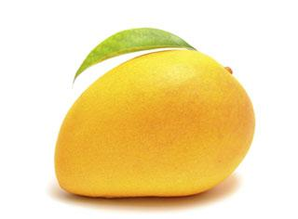
Top Machine learning terminologies to start with…

Slide 28
Term 1: Features
The number of distinct traits that can be used to describe each item in a quantitative manner.
Features-Distinct traits that decide taste of a mango
Output Feature variable- Taste of a mango
 | Color | Size | Shape | Which vendor | Which part of the country | Taste
Mango 1 | Yellow | Big | Oval | Local | Amritsar | Ripe
Mango 2 | Green | Small | Round | Foreign | England | Sweet
Mango 3 | Yellow | Small | Round | Local | Amritsar | Juicy

Slide 29





Term 2: Samples
A sample is an item to process. For instance, it could be an document, picture, sound, or a raw database.

Slide 30
Term 3: Feature vector
A feature vector is an n-dimensional vector of numerical features that represent some object
.
 | Color | Size | Shape | Which vendor | Which part of the country | Taste
Mango 1 | Yellow | Big | Oval | Local | Amritsar | Ripe
Mango 2 | Green | Small | Round | Foreign | England | Sweet
Mango 3 | Yellow | Small | Round | Local | Amritsar | Juicy
Feature vector- [Yellow,Big,Oval,Local,Amritsar,Ripe]

Slide 31
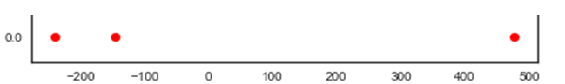
Term 4: Feature Extraction
Preparation of feature vector
Transforms the data from high-dimensional space to a space of fewer dimensions.
.
 | Color | Size | Shape | Which vendor | Which part of the country
Mango 1 | Yellow | Big | Oval | Local | Amritsar
Mango 2 | Green | Small | Round | Foreign | England
Mango 3 | Yellow | Small | Round | Local | Amritsar
Transforming 5D to 1D
Sweet
Juicy
Ripe
Notes:
** Try to have more meaningful representation such as highlight an actual data set and show which point is which part

Slide 32
Term 5: Training set
Set of data to discover potentially predictive relationships.
.
.
Training Data
 | Color | Size | Shape | Which vendor | Which part of the country | Taste
Mango 1 | Yellow | Big | Oval | Local | Amritsar | Ripe
Mango 2 | Green | Small | Round | Foreign | England | Sweet
Mango 3 | Yellow | Small | Round | Local | Amritsar | Juicy

Slide 33
Term 6: Test set
Set of data to validate the predictive relationship
Test Data
Mango 4 | Green | Big | Oval | Foreign | England | ?
Predictions are produced using the model

Slide 34

Term 7: Scoring
Evaluating the performance of a machine learning based on any statistical metric.
.
.
Accuracy

Slide 35





General Machine Learning process flow
Learning Algorithm
Training
Data
Produce a Model
Data
Test Data
Accuracy
Test Data
Test Data

Slide 36
Emergence of Machine Learning
What is Machine Learning
Types of Machine Learning
Types of Machine Learning
Model Evaluation
Model Explainability

Slide 37

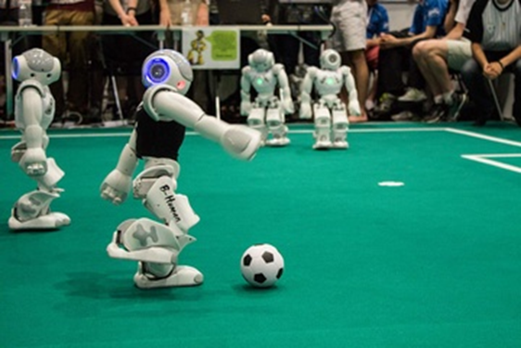
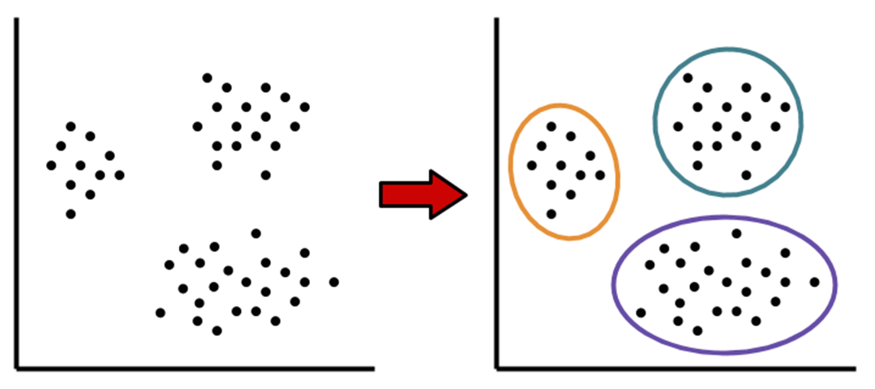
Types of Machine learning
Supervised learning
Unsupervised learning
Reinforcement learning
20
Notes:
** change images for both usupervised and reinforcement

Slide 38
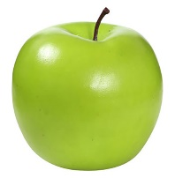
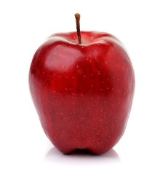

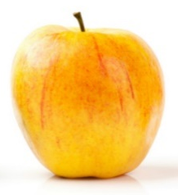
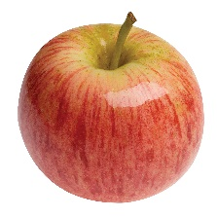

Supervised Learning: Learn from Examples
Supervised machine learning enables computers to learn from labeled data without being explicitly programmed.
Known data
Model
New response
It’s an apple
Known response
These are apples
21
New data

Slide 39


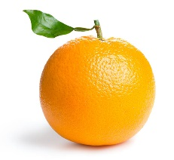
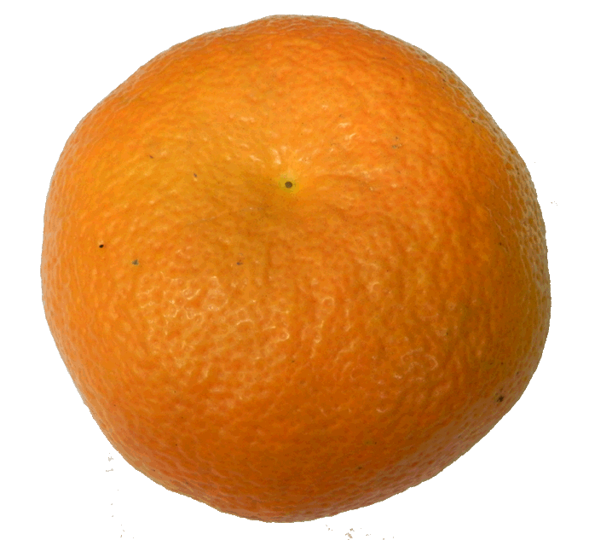
Unsupervised Learning: Uncover hidden patterns
Unsupervised learning draws inferences from data without labeled responses.
I can see patterns
Known data
Model
21

Slide 40



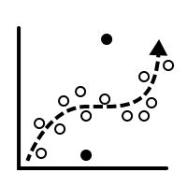
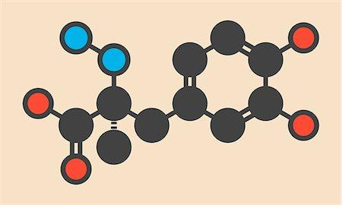
Supervised vs Unsupervised Learning
Supervised
Unsupervised
Direct Feedback
Labeled Data
No Feedback
Non-Labeled Data
Predictions as output
Find hidden structure in data

Slide 41


Reinforcement Learning: Learn by interaction with environment
Reinforcement learning develops algorithms when in direct interaction with environment and tunes itself from its mistakes using feedback.
Reinforced response
It’s a mango
Wrong! It’s an apple.
Noted!
It’s an apple!
Input
Response
Feedback
Learns
Input
21

Slide 42
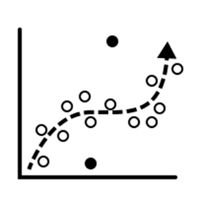
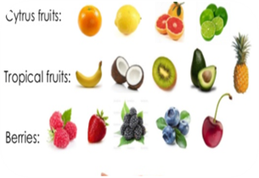
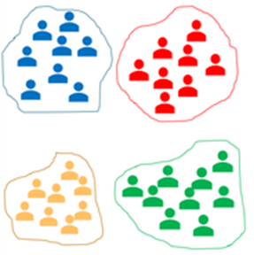
Types of problems solved through Machine learning
Regression
Classification
Clustering

Slide 43
Types of problems solved through Machine learning
Regression
Classification
Supervised Learning
Clustering

Slide 44

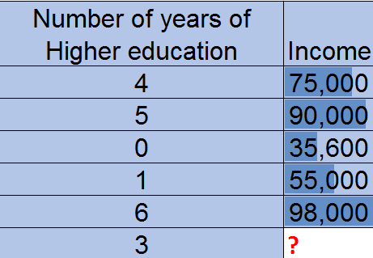

An example illustrating regression
A study is conducted by Stanford University in order to understand how the number of years of higher education affect the annual income of their graduated students.
Predict what would be annual income for 3 years of higher education

Slide 45

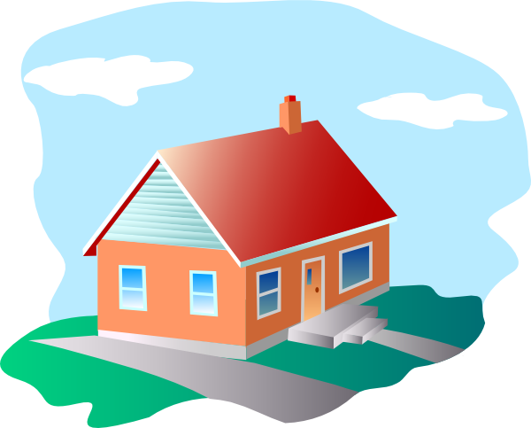


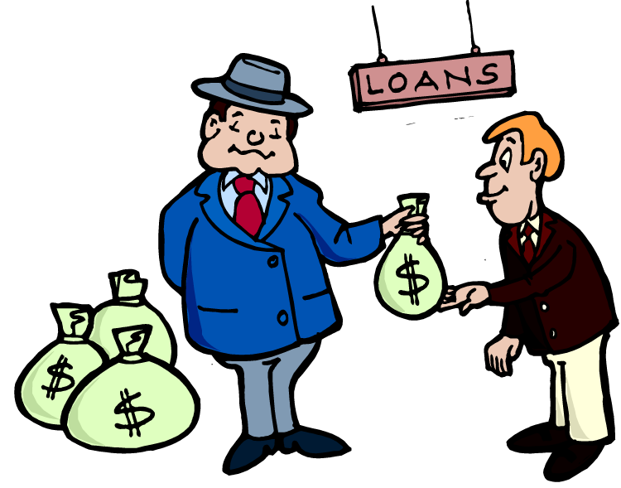
An example illustrating Classification
John wants to undertake a loan from Bank Of India in order to purchase a house. Banks conduct a thorough investigation about the person who desires to take a loan before granting one.
Will bank approve loan or not?
Yes No

Slide 46
Types of Problems solved through Machine learning
Regression
Classification
Clustering
Unsupervised Learning
22

Slide 47


Clustering topics in Google news
Categorization of news articles in Google news.
Notes:
Categorization of news articles on Google news.

Slide 48
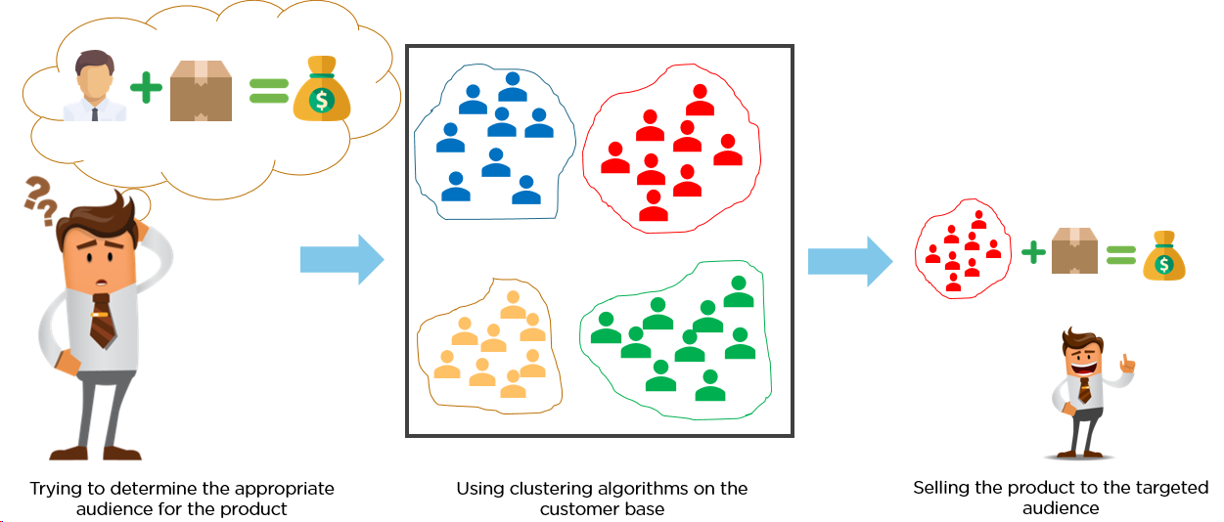
Clustering: Selling products to the right category of customers

Slide 49
Steps in a machine learning workflow
Model Objective
Model Evaluation
Gathering Data
Train the data
Data Preparation
Choose a model
23

Slide 50
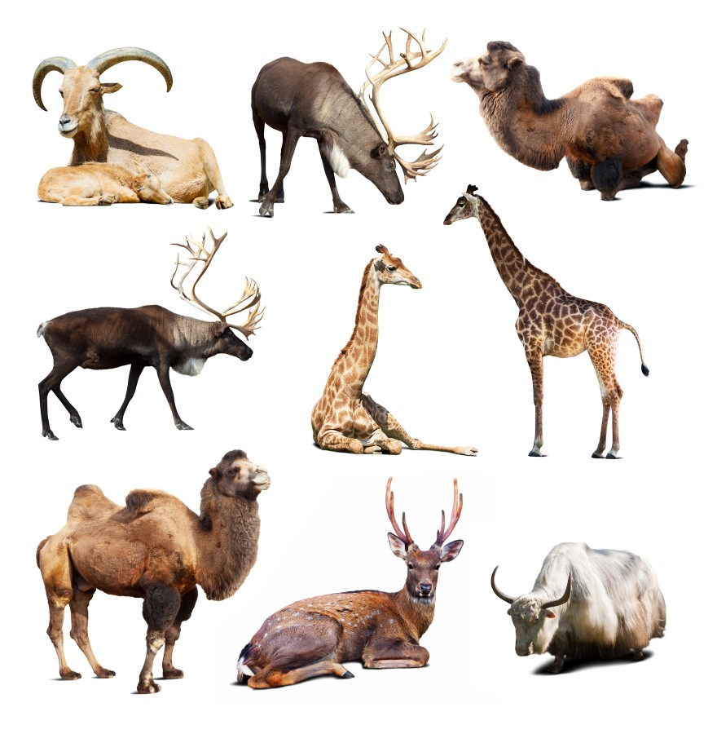
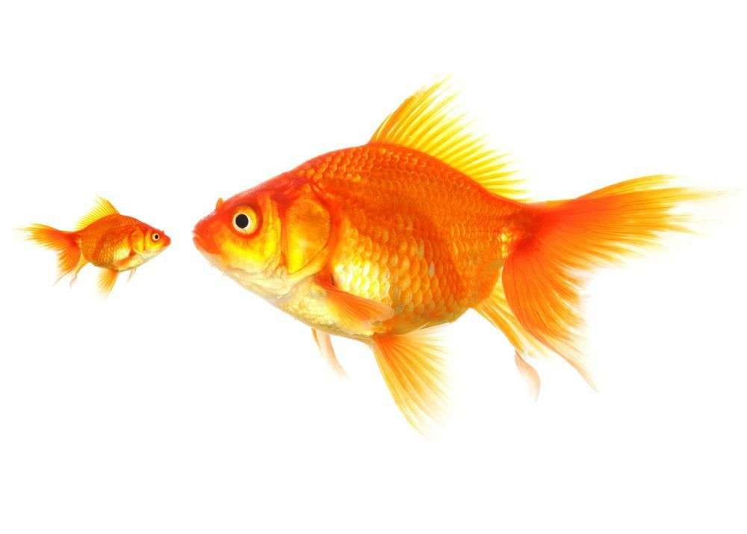
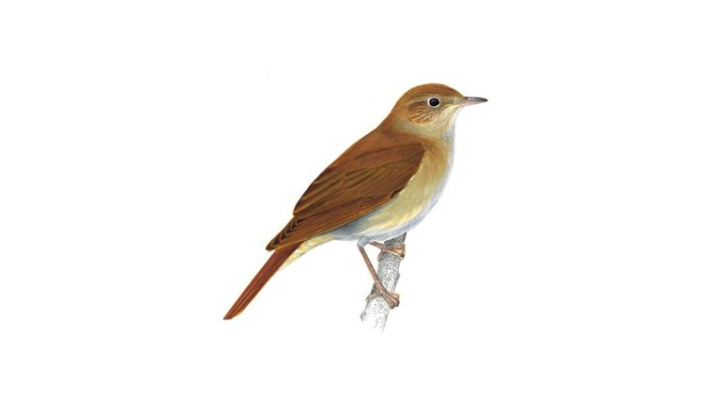
Step 1: Model objective
Classify animals into fish, mammal and bird
Fish
Bird
Mammals
23

Slide 51
Step 2: Gathering Data
Animal name | feathers | airborne | aquatic | toothed | backbone | breathes | venomous | fins | legs | tail | class type
dogfish | 0 | 0 | 1 | 1 | 1 | 0 | 0 | 1 | 0 | 1 | Fish
dolphin | 0 | 0 | 1 | 1 | 1 | 1 | 0 | 1 | 0 | 1 | Mammal
dove | 1 | 1 | 0 | 0 | 1 | 1 | 0 | 0 | 2 | 1 | Bird
duck | 1 | 1 | 1 | 0 | 1 | 1 | 0 | 0 | 2 | 1 | Bird
elephant | 0 | 0 | 0 | 0 | 1 | 1 | 0 | 0 | 4 | 1 | Mammal
flamingo | 1 | 1 | 0 | 0 | 1 | 1 | 0 | 0 | 2 | 1 | Bird
23

Slide 52
Step 3: Data Pre processing
Animal name | feathers | airborne | aquatic | toothed | backbone | breathes | venomous | fins | legs | tail | class type
dogfish | 0 | 0 | 1 | 1 | 1 | 0 | 0 | 1 | 0 | 1 | Fish
dolphin | 0 | 0 | 1 | 1 | 1 | 1 | 0 | 1 | 0 | 1 | Mammal
dove | 1 | 1 | 0 | 0 | 1 | 1 | 0 | 0 | 2 | 1 | Bird
duck | 1 | 1 | 1 | 0 | 1 | 1 | 0 | 0 | 2 | 1 | Bird
elephant | 0 | 0 | 0 | 0 | 1 | 1 | 0 | 0 | 4 | 1 | Mammal
flamingo | 1 | 1 | 0 | 0 | 1 | 1 | 0 | 0 | 2 | 1 | Bird
The features backbone, venomous and tail have same values for all animals and can thus be discarded.
23

Slide 53
Step 4: Choose a model
Animal name | feathers | airborne | aquatic | toothed | breathes | fins | legs | class type
dogfish | 0 | 0 | 1 | 1 | 0 | 1 | 0 | Fish
dolphin | 0 | 0 | 1 | 1 | 1 | 1 | 0 | Mammal
dove | 1 | 1 | 0 | 0 | 1 | 0 | 2 | Bird
duck | 1 | 1 | 1 | 0 | 1 | 0 | 2 | Bird
elephant | 0 | 0 | 0 | 0 | 1 | 0 | 4 | Mammal
flamingo | 1 | 1 | 0 | 0 | 1 | 0 | 2 | Bird
Choose any supervised learning algorithm since it has known labels.
Since labels are categorical, go for any classification algorithm.
23

Slide 54
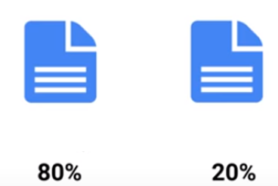
Step 5: Train data
Animal name | feathers | airborne | aquatic | toothed | breathes | fins | legs | class type
dogfish | 0 | 0 | 1 | 1 | 0 | 1 | 0 | Fish
dolphin | 0 | 0 | 1 | 1 | 1 | 1 | 0 | Mammal
dove | 1 | 1 | 0 | 0 | 1 | 0 | 2 | Bird
duck | 1 | 1 | 1 | 0 | 1 | 0 | 2 | Bird
elephant | 0 | 0 | 0 | 0 | 1 | 0 | 4 | Mammal
flamingo | 1 | 1 | 0 | 0 | 1 | 0 | 2 | Bird
Produce a Model
Test Data
Feed training data
Training Data
23

Slide 55

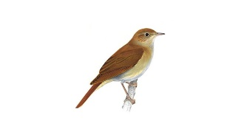
Step 6: Model Evaluation
Predict unknown test data using trained model and check if predictions are correct.
Model
Predictions
Mammal
Feed test data
Bird

Slide 56
Emergence of Machine Learning
What is Machine Learning
Model Evaluation
Types of Machine Learning
Model Evaluation
Model Explainability

Slide 57
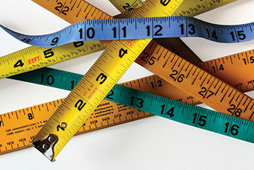
How good or bad your model is: Let us evaluate
The following metrics are used to measure model performance.
MAE: Mean absolute Error
MSE: Mean Squared Error
RMSE: Root Mean Squared Error

Slide 58
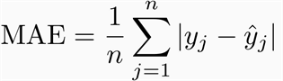
Mean Absolute Error(MAE)
MAE is the average absolute difference between actual and predicted values.
Characteristics:
Neutral to outliers
Error is in same units as that of the data points.
Notes:
To calculate MAE;
First calculate the absolute difference between original and predicted value.
Sum all the errors
Divide by the total number of observations

Slide 59
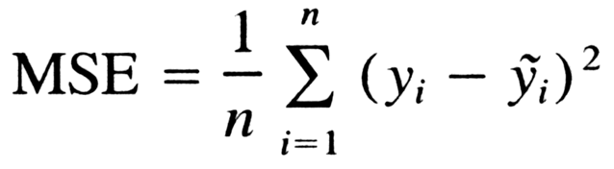
Mean Squared Error(MSE)
MSE is the average squared difference between actual and predicted values.
Characteristics:
Accounts impact of outliers.
Error is NOT in same unit as that of the data points .
Notes:
To calculate MSE;
First calculate the square of the difference between original and predicted value.
Sum all the squared errors
Divide by the total number of observations
Each error is squared- (yi – ŷ)².
Find the sum of each squared error- ∑ (yi – ŷ)².
Find mean by dividing the sum with no. of observations(n)- ∑ (yi – ŷ)²/n.

Slide 60
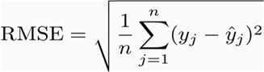
Root Mean Squared Error(RMSE)
RMSE is the square root of the average squared difference between actual and predicted values.
Characteristics:
Accounts impact of outliers.
Error is in same unit as that of the data points.
Notes:
To calculate RMSE;
First calculate the square of the difference between original and predicted value.
Sum all the squared errors
Divide by the total number of observations
Find the square root of the resulting value
Each error is squared- (yi – ŷ)².
Find the sum of each squared error- ∑ (yi – ŷ)².
Find mean by dividing the sum with no. of observations(n)- ∑ (yi – ŷ)²/n.
Finally find the root- √ ∑ (yi – ŷ)²/n.

Slide 61
Calculate error metrics with Pizza sales without outliers
Student population | Quarterly Sales(y)
2 | 58 | 70 | -12 | 12 | 144
6 | 105 | 90 | 15 | 15 | 225
8 | 88 | 100 | -12 | 12 | 144
10 | 118 | 110 | 8 | 8 | 64
12 | 117 | 120 | -3 | 3 | 9
16 | 137 | 140 | -3 | 3 | 9
20 | 157 | 160 | -3 | 3 | 9
24 | 169 | 180 | -11 | 11 | 121
22 | 149 | 170 | -21 | 21 | 441
26 | 202 | 190 | 12 | 12 | 144
 |  |  |  | 100 | 1310

Slide 62
RMSE & MAE: Which metric is better without outliers?
Both RMSE & MAE are used to measure the model’s accuracy. The decision of choosing specific metric depends on domain of interest.
Mean absolute error | 10
Mean square error | 131
Root mean square error | 11.45
Notes:
**find examples for each case
** this has different mathematical magnitude, not to be multiplied by 100
** fluctuation the true value can have +-

Slide 63
Calculate Error metrics with Pizza sales with outliers
Student population | Quarterly Sales | Predicted Quarterly Sales | Error | Absolute Error | (Absolute Error) ^2
2 | 58 | 70 | -12 | 12 | 144
6 | 105 | 90 | 15 | 15 | 225
8 | 88 | 100 | -12 | 12 | 144
10 | 118 | 110 | 8 | 8 | 64
12 | 167 | 120 | 47 | 47 | 2209
16 | 137 | 140 | -3 | 3 | 9
18 | 180 | 150 | 30 | 30 | 900
20 | 157 | 160 | -3 | 3 | 9
21 | 260 | 165 | 95 | 95 | 9025
22 | 149 | 170 | -21 | 21 | 441
24 | 169 | 180 | -11 | 11 | 121
25 | 230 | 185 | 45 | 45 | 2025
26 | 202 | 190 | 12 | 12 | 144
 |  |  |  | 314 | 15460

Slide 64
Calculate MAE, MSE & RMSE with outliers
In RMSE, since errors are squared before they are averaged , RMSE gives relatively high weight to large error.
Thus RMSE is more useful when large errors occur.
RMSE scales to original units.
Mean absolute error | 24
Mean square error | 1189
Root mean square error | 34.5
Notes:
Blows up large error
Scales to original units
In general, use rmse(go to metric)

Slide 65

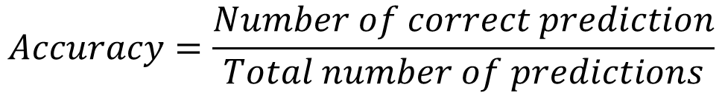
What is Classification accuracy?
Classification accuracy is number of correct predictions made divided by total number of predictions.

Slide 66



Let’s have a look at Sam’s email account
Email account contains a total of 10000 emails with 9671 genuine emails and 329 spam emails.
Email
……..
……
Ham
Spam
9671
329
Notes:
.

Slide 67
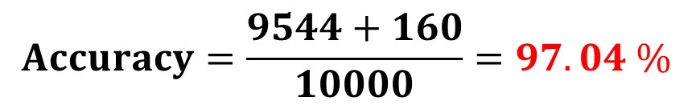
Let’s build a spam classifier model
After passing email data through the model we correctly classify 9544 emails as ham and 160 emails as spam.
Email
……..
……..
……
Ham
Spam
9544
160
Notes:
Suppose Sam’s email account contains 9671 genuine emails and 329 spam emails.
Let’s build a spam classifier that classifies all emails as genuine

Slide 68

Hurrah a 97 % accuracy!
But what is wrong with this?
Let’s find out…

Slide 69
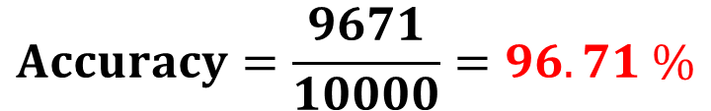
What if we build a model to classify all emails as ham?
For a model that classifies all emails as ham, all ham emails are correctly classified whereas
all spam emails are wrongly classified.
……..
……..
……
Ham
Ham
9671
329
Notes:
There is not much difference between the accuracies of the dumb model and our original model.

Slide 70





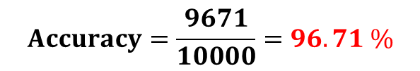
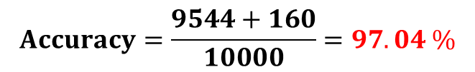
No significant difference in accuracy between models
Dumb Model: Predict all are ham
Original Model
…
…
...
…
Ham
Spam
Ham
Spam
9671
329
9544
160
It is evident that accuracy for a dumb model is not much different from our original model.

Slide 71

No significant difference in accuracy between models
In cases where there is imbalance in data, accuracy is not an adequate metric to explain performance of model.
Spam
Ham
329
9671
Notes:
.

Slide 72
Lets solve drawbacks of classification accuracy by confusion matrix…

Slide 73



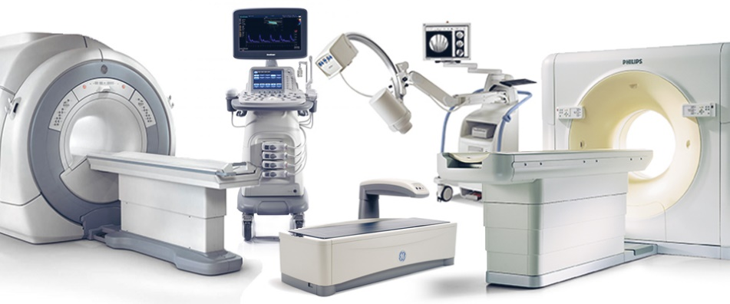
Let’s consider a medical model
Jones’ hospital has revamped its medical facilities and wants to analyze if it is making correct diagnosis using its newly imported medical equipment.

Slide 74

Confusion matrix
A confusion matrix is a table that helps understand performance of a classification model on test data for which true values are known.
Predicted classes
 | Diagnosed Healthy | Diagnosed Sick
Healthy | 118 | 12
Sick | 47 | 15
Actual classes
Notes:
The number of correct and incorrect predictions are summarized with count values and broken down by each class.
The confusion matrix shows the ways in which your classification model is confused when it makes predictions.
It gives you insight not only into the errors being made by your classifier but more importantly the types of errors that are being made.

Slide 75
Performance measures derived from confusion matrix
Confusion Matrix
True Negative
False Positive
True Positive
False Negative
Specificity
Precision
Sensitivity or Recall

Slide 76
Performance measures obtained from confusion matrix
Predicted classes
 | Event | No Event
Event | True positive | False Negative
No Event | False Positive | True Negative
True positive: Number of correctly predicted event values.
False positive: Number of incorrectly predicted event values.
True negative: Number of correctly predicted no-event values.
False negative: Number of incorrectly predicted no-event values.
Actual classes
.
.
Notes:
Suppose there are three classes,

Slide 77
Confusion matrix for a medical model
Predicted classes
 | Diagnosed Healthy | Diagnosed Sick
Healthy
Sick
True Positives (TP): Healthy people correctly predicted as Healthy
False Positives (FP): Healthy people incorrectly predicted as Sick
True positive
False positive
Actual classes
False Negatives (FN): Sick people incorrectly predicted as Healthy
True Negatives (TN): Sick people correctly predicted as Sick
False negative
True
negative
Notes:
Confusion matrix displays count of actual and predicted classifications.

Slide 78
Let’s revisit spam classifier model
After passing email data through the model we correctly classify 9544 emails as ham and 160 emails as spam.
Email
……..
……
Ham
Spam
9544
160
Notes:
Suppose Sam’s email account contains 9671 genuine emails and 329 spam emails.
Let’s build a spam classifier that classifies all emails as genuine

Slide 79

Confusion matrix for a spam classifier model
Predicted classes
 | Spam | Ham
Spam
Ham
True Positives (TP): spam correctly predicted as spam
False Positives (FP): spam incorrectly predicted as ham
True positive
False negative
Actual classes
False Negatives (FN): ham incorrectly predicted as spam
True Negatives (TN): ham correctly predicted as ham
False positive
True
negative
Notes:
Confusion matrix displays count of actual and predicted classifications.

Slide 80
Confusion matrix for a spam classifier model
Predicted classes
 | Spam | Ham
Spam |  | 169
Ham | 127 | 9544
160
True positive
False negative
Actual classes
False positive
True
negative
Notes:
Confusion matrix displays count of actual and predicted classifications.

Slide 81
Significance of performance measures on two models
Medical Model
Spam Classifier Model
False Positive False Negatives
Diagnosing a sick person as healthy is dangerous.
False Negatives False Positives
Classifying an important email as spam is not desirable.
Notes:
Cross and tick

Slide 82
Few other performance measures derived from confusion matrix
Confusion Matrix
True Negative
False Positive
True Positive
False Negative
Specificity
Precision
Sensitivity or Recall

Slide 83
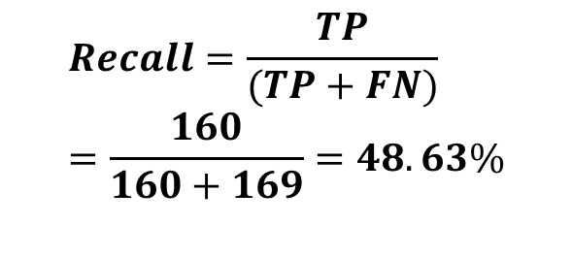
Recall
Recall also known as sensitivity is a measure of how often predictions are correct when actual value is positive.
Predicted classes
 | Spam | Ham
Spam |  | 169
Ham | 127 | 9544
Of the mails that are actually spam, how many are classified as spam?
160
True positive
False negative
Actual classes
False positive
True
negative
Notes:
Recall and Precision are disjoint sets of measures.

Slide 84
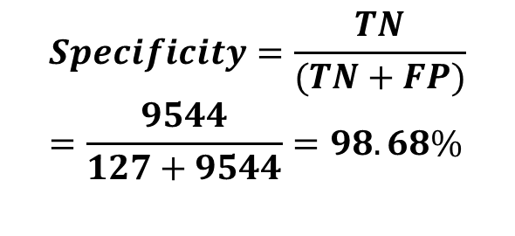
Specificity
Specificity is a measure of how often predictions are correct when actual value is negative.
Predicted classes
 | Spam | Ham
Spam |  | 169
Ham | 127 | 9544
Of the mails that are actually ham, how many are classified as ham?
160
True positive
False negative
Actual classes
False positive
True
negative
Notes:
Recall and Precision are disjoint sets of measures.

Slide 85

Let’s talk about Precision
Precision is a measure of how often predictions are correct when predicted value is positive.
Predicted classes
 | Spam | Ham
Spam |  | 169
Ham | 127 | 9544
Of the mails classified as spam, how many are actually spam?
160
True positive
False negative
Actual classes
False positive
True
negative

Slide 86













Analogy to Precision and Recall through apples
Suppose Sam visits a fruit stand to buy apples—but more specifically, search criteria was “red, medium-sized fruit.”
apple
apple
Bell pepper
watermelon
Pomegranate
banana
pineapple
Large tomato
apple
apple
lemon
kiwi
large apple
Notes:
Cross and tick

Slide 87









Precision of finding apples
Precision is percentage of the results that are correct.
3 of the 6 results are apples, so Precision of this resulting set is (3 ÷ 6) × 100, or 50%
apple
apple
Bell pepper
watermelon
Pomegranate
banana
pineapple
Large tomato
apple
apple
large apple
lemon
kiwi
Notes:
Cross and tick

Slide 88
Recall of finding apples
There are 5 apple choices among the 13 fruits types available at the stand.
Recall is percentage of correct items that are returned in the search results.
The Recall for apple search is (3 ÷ 5) × 100, or 60%.
apple
apple
Bell pepper
watermelon
Pomegranate
banana
pineapple
Large tomato
apple
apple
lemon
kiwi
large apple
Notes:
Cross and tick

Slide 89
An example where Precision and Recall is used…

Slide 90


Recall and Precision for Google search engine
12.1 million
2 million relevant results
6 million relevant results NOT returned by Google
Recall=Probability of Google’s algorithm to retrieve all the relevant links = 2/(2+6)=0.25
Precision=Probability that all retrieved links were relevant = (2/12.1)=0.165.
Notes:
Let’s say we searched on Google for “what is precision and recall?” and in less than a minute I have about 12.1 million results.
Let’s say out of these 12.1 million results, the relevant links to my question were about 2 million. Assuming there were also about 6 million more results that were relevant but weren’t returned by Google, for such system we would say that it has a precision of 2M/12.1M and a recall of 2M/8M.

Slide 91
Emergence of Machine Learning
What is Machine Learning
Types of Machine Learning
Model Evaluation
Model Explainability
Why we need to explain models?
ELI5
LIME
SHAP

Slide 92

Black Box Models
This is how Machine Learning Engineers explain model outputs to people.

Slide 93


Informed Decision Making
Machine Learning model predicts a cancer. But why?
You cannot explain why it gets a certain output.

Slide 94

Fixing bugs in model
It is important to identify the mistakes made by the model and take steps to fix it.

Slide 95
Emergence of Machine Learning
What is Machine Learning
Types of Machine Learning
Model Evaluation
Model Explainability
Why we need to explain models?
ELI5
LIME
SHAP

Slide 96
What is ELI5
E
L
I
5
Explain
Like
Eli5 is a Python package which helps visualize and debug various Machine Learning models.
I’m
Five

Slide 97
Features of Eli5 package
Eli5 is a Python package which helps debug machine learning models and explain their predictions.
Eli5 can support many machine learning packages such as:
Scikit-learn
XGBoost
LightGBM
Eli5 implements many algorithms to explain black box estimators:
Text Explainer: Explains the classification of text based models
Permutation Importance: Works with Tabular data to explain the importance of each feature columns.

Slide 98

Text Explainer
Eli5 provides an implementation of LIME algorithm which allows to explain the predictions of different classifiers including text classifiers.
The following document is classified as medical news data because of the highlighted words.

Slide 99


Steps to evaluate Permutation Evaluation
Tabular Data
Evaluate Permutation Importance
Fit a model
Shuffle the data

Slide 100

Permutation Importance
This is used to identify the features which are important to the model and have an impact on the predictions.
Consider the above data. Our goal is to predict what is the person’s height when the age is 20.
For this first we will take the entire data and build a model.

Slide 101

How to calculate Permutation Importance?
After building the model we can make certain predictions.
Now we will randomly reorder a predictor columns and see how it impacts the predictions.
Shuffling an importance columns should cause less prediction accuracy and shuffling a low importance column should not have an impact.

Slide 102
Eli5 explanations
Weight | Features
0.0750 ± 0.1159 | Height at age 10 (cm)
0.0035 ± 0.0729 | Socks owned at age 10
The features in the top rows are the most important and their importance decreases as we go down the rows.
The numeric value in the weights column explains how much the output varies due to shuffling of the corresponding feature.

Slide 103
Emergence of Machine Learning
What is Machine Learning
Types of Machine Learning
Model Evaluation
Model Explainability
Why we need to explain models?
ELI5
LIME
SHAP

Slide 104
What is LIME
L
I
M
E
OCAL
NTERPRETABLE
Lime treats any model as a black box and provide explanations which can be easily understood.
ODEL-AGNOSTIC
XPLANATIONS

Slide 105

How does LIME works

Slide 106

What do you mean by Local?
In this dataset we are trying to determine whether a mushroom is edible or not.
The blue region is one class(edible) and the orange is another(inedible).
We will try to understand the prediction in the red bold cross.
Step 1: LIME will randomly sample instances that are in proximity of the prediction point.
Step 2: Build a simple model(like decision tree or logistic regression) which will explain the predictions locally but not globally.
The dashed line separates the two classes locally in the sample which can be easily explained.

Slide 107


Model Agnostic Explanations
LIME can provide explanations of any type of model like decision tree, Xgboost and neural networks.

Slide 108

Types of Explanations with LIME
There are 3 types of explainers in LIME
LIME Text Explainer
LIME Image Explainer
LIME Tabular Explainer
LIME Text Explainer

Slide 109

LIME Image Explainations
LIME creates superpixels to aid in image recognition.

Slide 110

LIME Tabular Explainations
Here is the LIME explanation of a model built on mushroom dataset.
The output of LIME is a list of explanations which tells the contribution of each feature on the data sample.
This helps us understand which feature changes will have most impact on the prediction.

Slide 111
Emergence of Machine Learning
What is Machine Learning
Types of Machine Learning
Model Evaluation
Model Explainability
Why we need to explain models?
ELI5
LIME
SHAP

Slide 112



Machine Learning models without explanations
The model predicted that this person will default loan payment.
Notes:
John goes to a bank for a car loan. But his loan application gets rejected.
He wants to speak to the manager who just replies that it is just an output of ML model and he cant explain why?

Slide 113
Accuracy vs Explainability Trade-offs
If the bank uses simple models like Logistic Regression or Decision Tree they can easily explained.
These are basic models with standard performance.
If the bank uses complex models like XGBoost and Deep Learning they can obtain really good accuracy.
These models are black box models with no explanations.
We have to choose between accuracy and interpretable model

Slide 114

Machine Learning models with explanations
The model rejected the loan application due to poor credit score.
Notes:
The manager has an explainer which can explain that the model rejected the application due to poor credit score.

Slide 115
SHAP Package
SHAP (SHapley Additive exPlanations) is a unified approach to explain the output of machine learning models.
It beaks down a prediction to show the impact of each variable.

Slide 116

Shapley Values
Shapley Values or Shap values is a technique used in game theory to determine how much each player in a collaborative game has a contribution to its success.
In our case Shap values are used to measure how much each feature in the model contributes to the prediction.
Notes:
https://towardsdatascience.com/one-feature-attribution-method-to-supposedly-rule-them-all-shapley-values-f3e04534983d

Slide 117


How do SHAP works?
The basic idea is to train a much simpler and interpretable model(i.e. a linear model or decision tree) on top of the originally trained model so that it approximates the original predictions.
These predictions can now be explained by the simpler model.

Slide 118

Prediction Explainer
Shap is used to explain individual predictions and the impact of each feature on the predictions.
In this example looking at a model trained on Pima Indian Dataset and we check if a person is at a risk of diabetes or not.
We predict that there is a 0.2% chance to be diabetic compared to base probability of 0.34%
The probability is low because BMI = 25 and Glucose = 109 which are normal levels in healthy person
This probability is increased due to Skin Thickness = 27 and Pregnancies = 6

Slide 119

Dependence Plot
This tells us how Glucose and Insulin are dependent on one another in terms of their impact on the model.
Glucose is linearly correlated with diabetes.
Glucose below 125, Shap values are negative and probability of diabetic decreases.
Red and blue points are not separable and hence glucose cannot alone explain the probability of diabetes. We need to look at other features as well.
Notes:
** Glucose is linearly correlated with overall prediction
** Ideally red and blue should be separate
** This is a single conclusion but not very accurate. We need to look at the importance of other features as well. Additive conclusion

Slide 120

Summary Plot
Glucose, BMI are important factors for diabetes.
High Glucose, BMI have a positive relation with increase in chances of diabetic.

